Slide 1
dHAP4 STEM Profiles

Slide 2
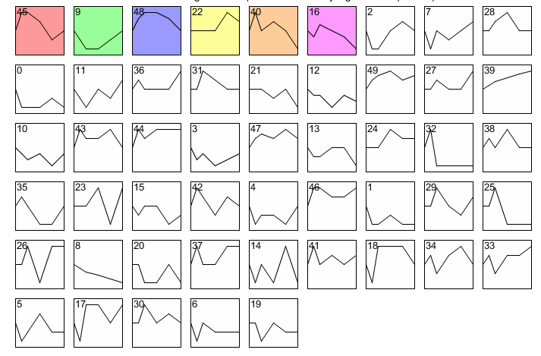
dHAP4 all STEM Profiles

Slide 3
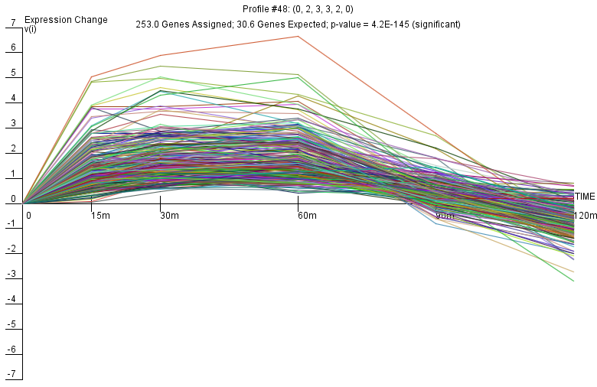
dHAP4 Profile 48

Slide 4
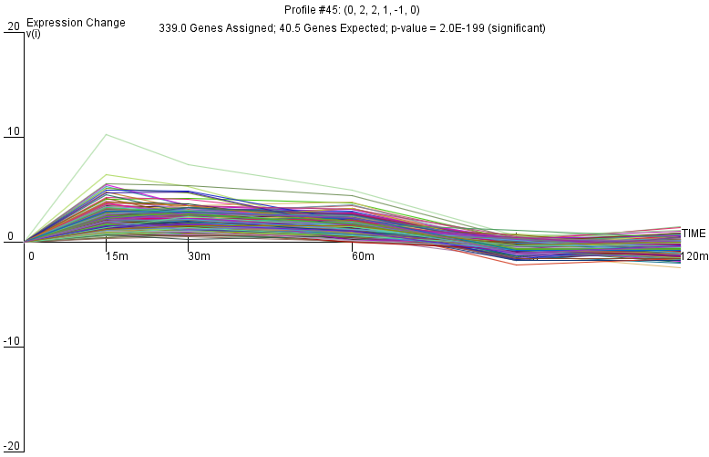
dHAP4 Profile 45

Slide 5
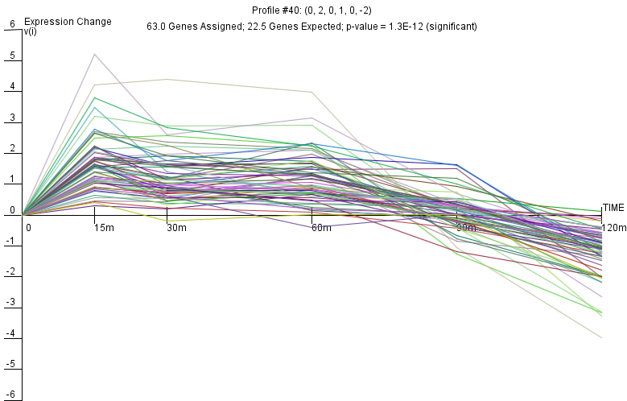
dHAP4 Profile 40

Slide 6
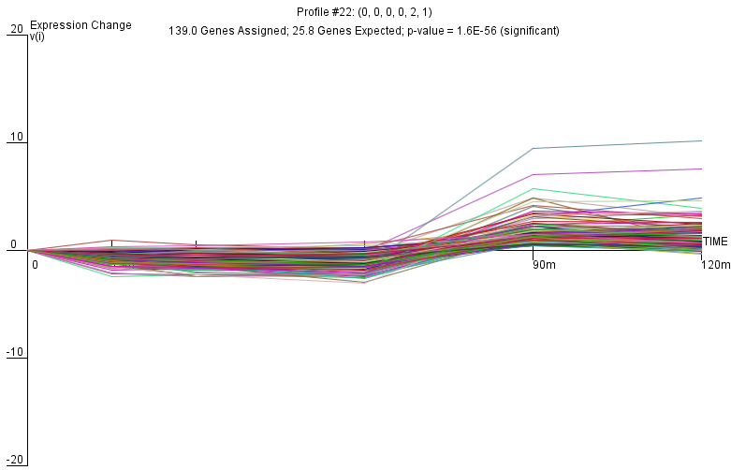
dHAP4 Profile 22

Slide 7
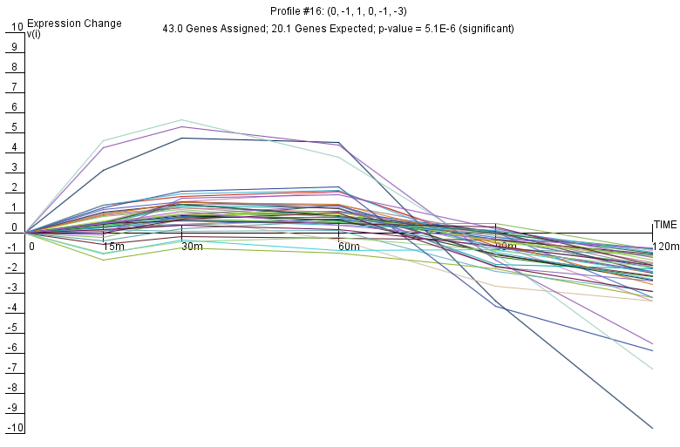
dHAP4 Profile 16

Slide 8
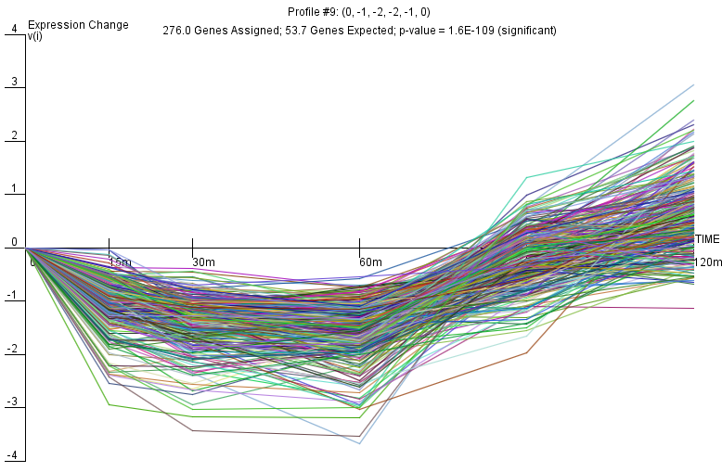
dHAP4 Profile 9

